Slide 1
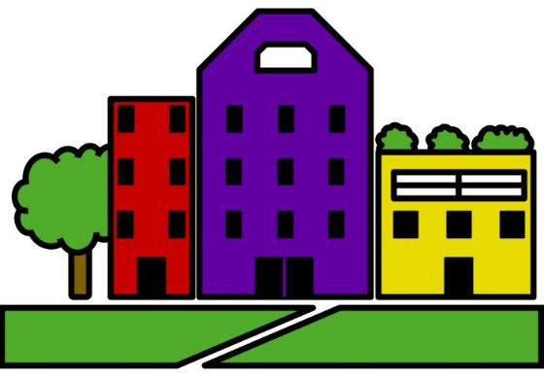
Decatur Parks and Greenspace
www.downtowndecaturneighbors.com
George Dusenbury
Chair, Downtown Decatur Neighbors
gdusenbury4@gmail.com
404-604-7803
Notes:
Make connection between DDN and parks. Schools, walkability, retail. Walking to Kroger.

Slide 2
City of Decatur:
Vision, Foresight, Innovation
1982 Town Center Plan
2000 Strategic Plan
2010 Strategic Plan
Notes:
The City of Decatur has a history of innovation and vision in tackling problems. In 1982, before new urbanism, smart growth and livable centers were buzzwords, Decatur created its Town Center Plan – envisioning a dense, vibrant downtown where asphalt parking lots dominated. And then the City committed the energy and resources to make that plan happen. The 2000 and 2010 Strategic Plans built upon and expanded that vision.

Slide 3
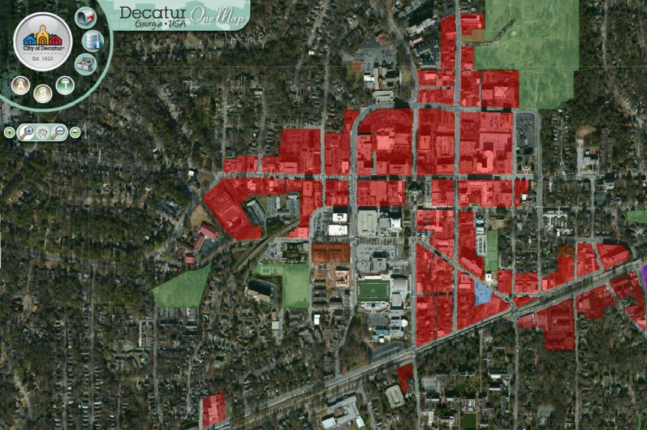
1982 Plan: Encourage Significant Density
Notes:
Uniform Design Ordinance
Special Pedestrian Area
Delisting Ponce as a state route
Relocating MARTA buses to new round-about
Reconfiguring the square, closing roads

Slide 4
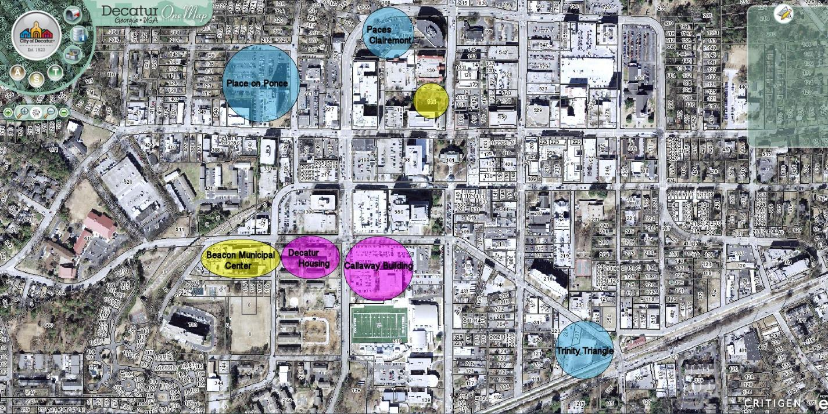
600+ Homes Are Under Construction
Notes:
Decatur’s efforts have been very successful. Currently, about 25% of all Decatur homes are in downtown. By the end of this year, more than 30% of all homes will be downtown. The retail and restaurant districts are thriving. The square is so popular that it is hard to keep the grass alive.
In 1996, there were 1060 residential units. In 2008, there were 1678 with the completion of Artisan Phase II – an increase of 628 units over 12 years.
There currently are 611 new units under construction at the Place on Ponce, 160 Clairmont and the Trinity Triangle. When completed, Decatur will have doubled downtown residences in less than 20 years with more development on the way at the Callaway Building and elsewhere.
DHA’s 191 units at Allen Wilson and 98 at Swanton Way.

Slide 5
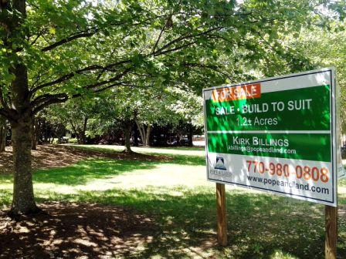
Our Greenspaces Are Disappearing
Notes:
Behind the Emory property
The east side of Commerce by the cemetery
Oakhurst Dog Park
Woodland Gardens (corner lot on Clairmont & Scott)

Slide 6
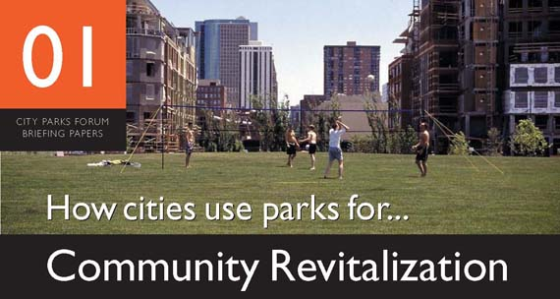
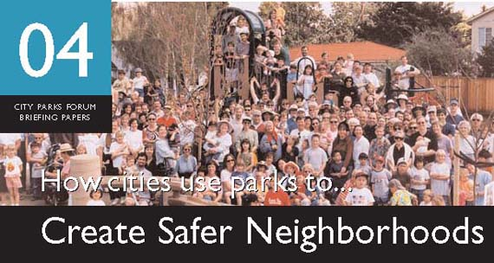
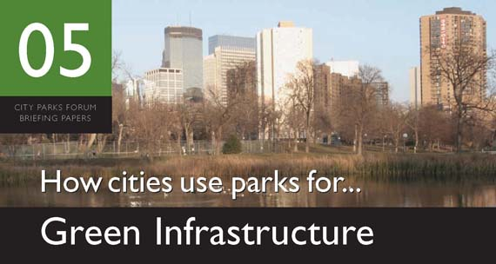
Parks Are Integral to Successful Cities
Notes:
There are thousands of downtown residents who have no yard, no lawn and a very limited access to passive parkland This matters because parks have a tremendous impact on quality of life. The American Planning Association has developed 11 briefing papers detailing how cities use parks for everything from community revitalization to coping with climate change.

Slide 7
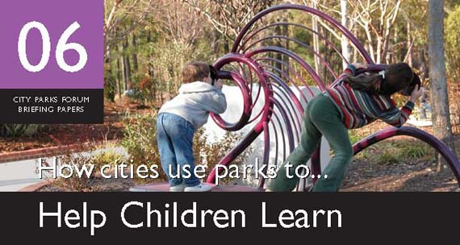
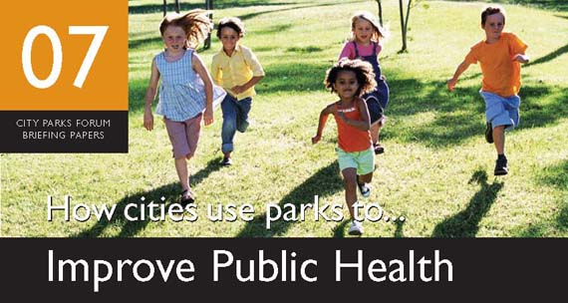
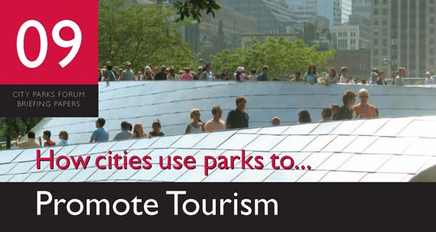
Parks Are Integral to Successful Cities

Slide 8
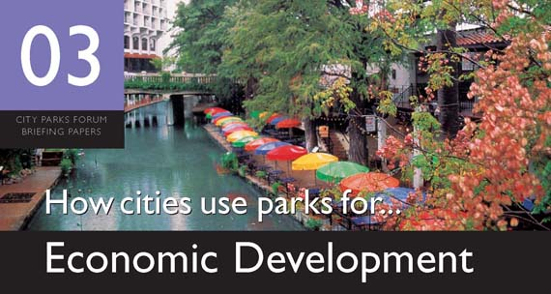

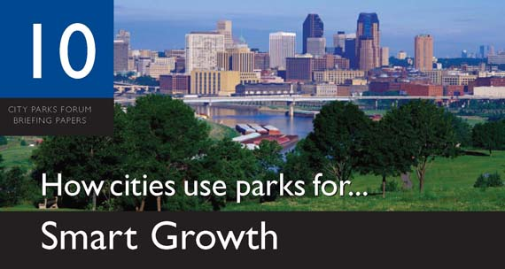
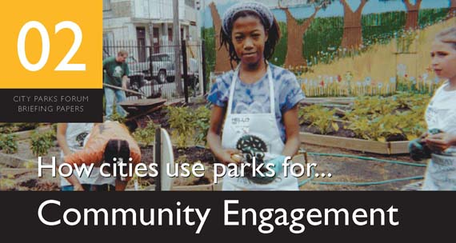
Parks are Integral to Decatur’s Strategic Plan
Manage Growth While Retaining Character
Encourage a Diverse and Engaged Community
Serve as Good Stewards of the Environment and Community Resources
Support a Safe, Healthy, Lifelong Community
Provide the Necessary Support within Government to Achieve the Visions and Goals of the Community
Notes:
Everything in Decatur is based on its strategic plan. Fortunately, parks are not just consistent with, but actually are a tool toward implementing each priority in the strategic plan.
Enhance mixed development, offset density concerns, strengthen the urban core and protect the fringe from overdevelopment.
Because parks can drive economic development, they even can help provide the resources needed to create parks.

Slide 9
Decatur Needs More Parks
SOURCE DATA: The Center for City Park Excellence (Trust for Public Land); City of Decatur web site.
U.S. AVG1 is data for cities with medium-high density. U.S. AVG2 is data for cities with medium-low density (Atlanta is classified as medium-low)
Notes:
Unfortunately, Decatur does not have enough parks. Using the two most common methods for assessing whether a City has enough parks (park acres per thousand residents, percent of land dedicated to parks), Decatur is about half the national average – and well below the City of Atlanta.

Slide 10
There are many ways to “fund” new parks
Tax Increment Financing
Transfer of Development Rights
Park Impact Fee
Open Space Banking
Storm Water Banking
Private Funding
Sell Current Assets (Decatur Conference Center)
Collaborate with Governmental Partners (CSD, DHA)
Repurpose Existing Public Land (streets & parking lots)
General Obligation Bond/Property Tax
Notes:
Fortunately, there are many ways to create new parks.

Slide 11
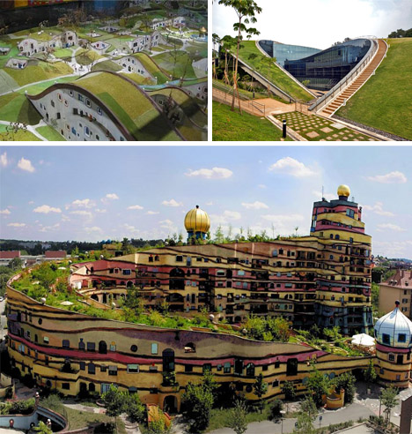
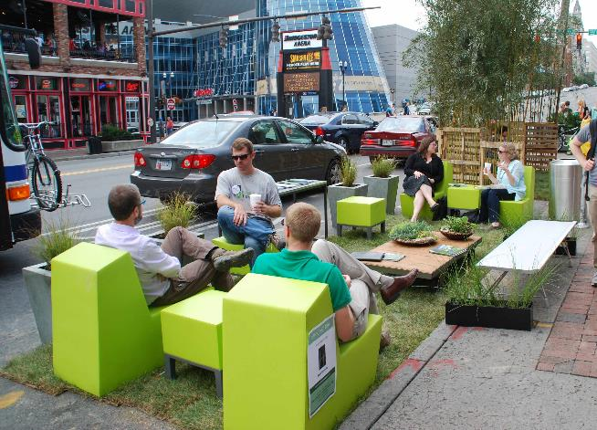
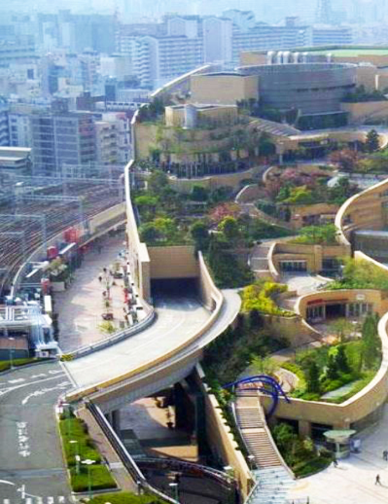
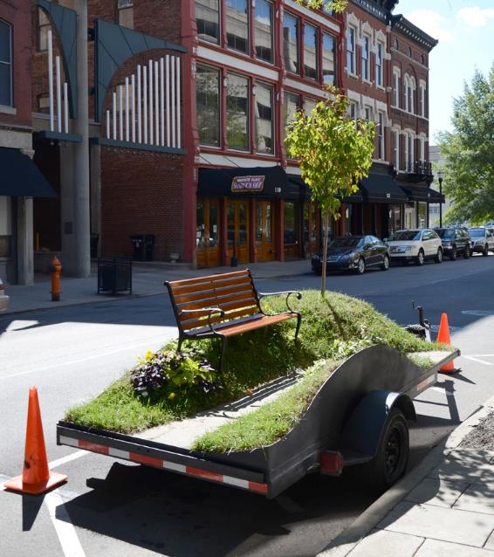
A Vision for Parks in Decatur: What’s Possible?
Notes:
I am here today to ask that you work with us to define a vision for parks in the City of Decatur. To imagine what the public spaces in our city will look like in 20 years. To be creative and bold – just like the city was more than 30 years ago when it adopted its 1982 Town Center Plan.

Slide 12
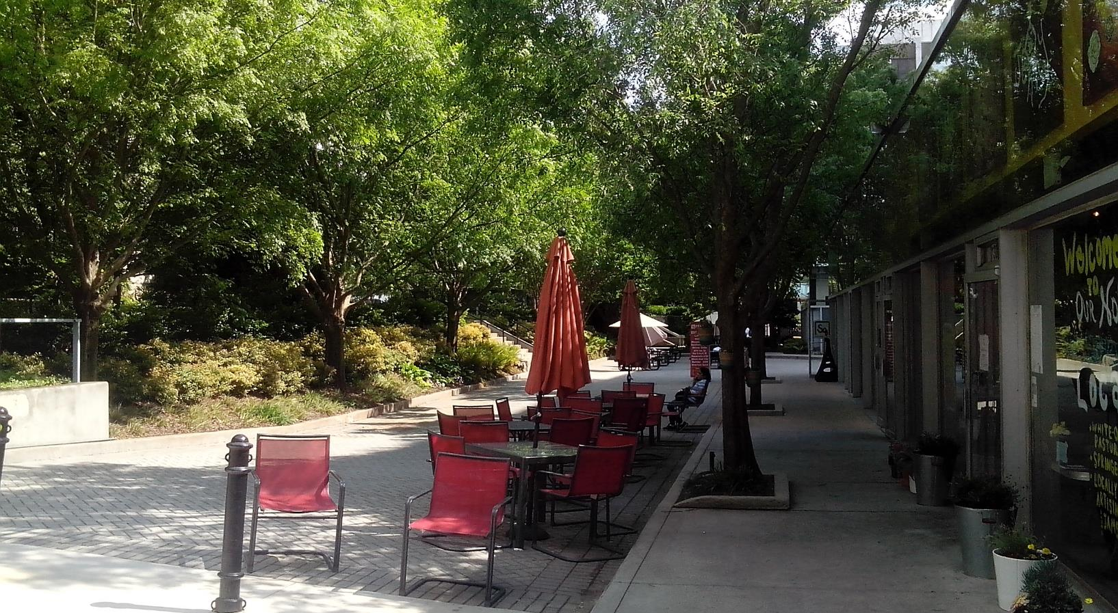
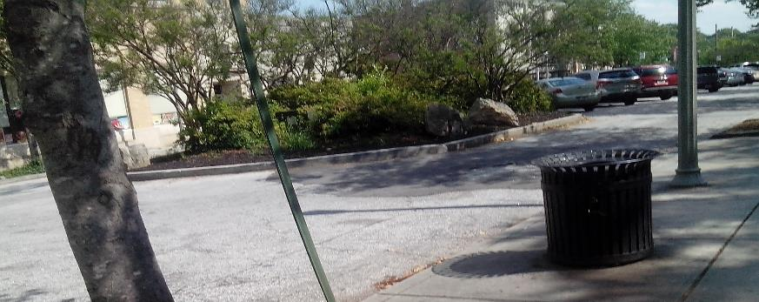
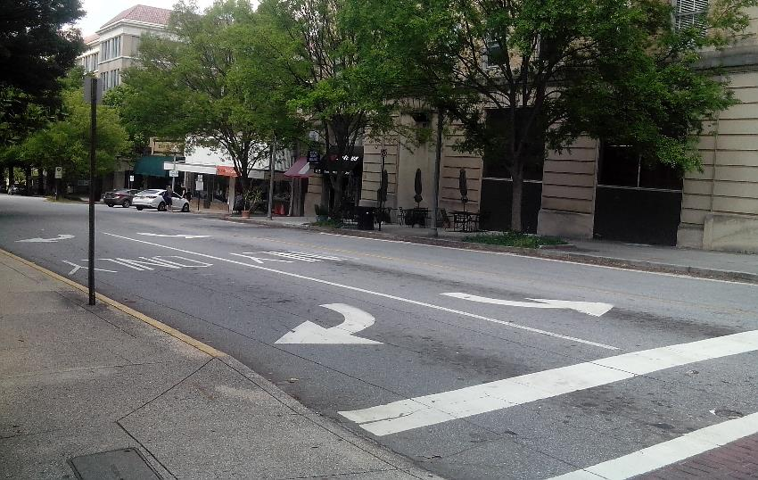
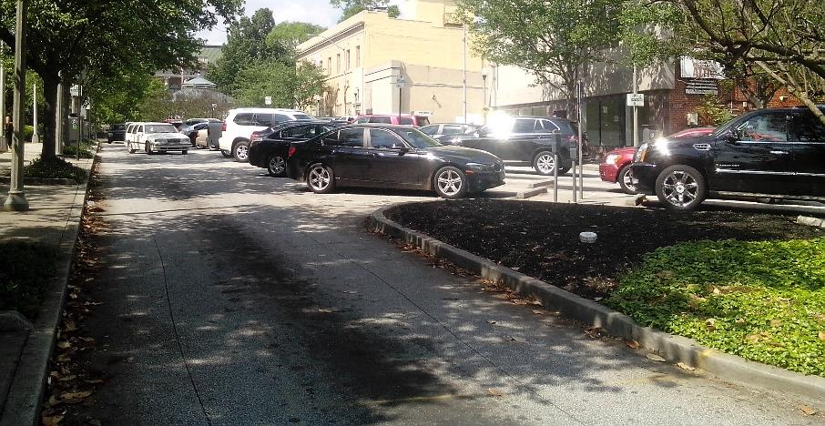
A Vision for Parks in Decatur: What’s Possible?
Streets (Clairemont, Ponce)
Parking Lots
Notes:
There are opportunities lurking all over the City. Here are a few in downtown, where the need for new public spaces is the greatest (just look at how we are loving the square to death), as is the pressure to develop each unimproved parcel.

Slide 13
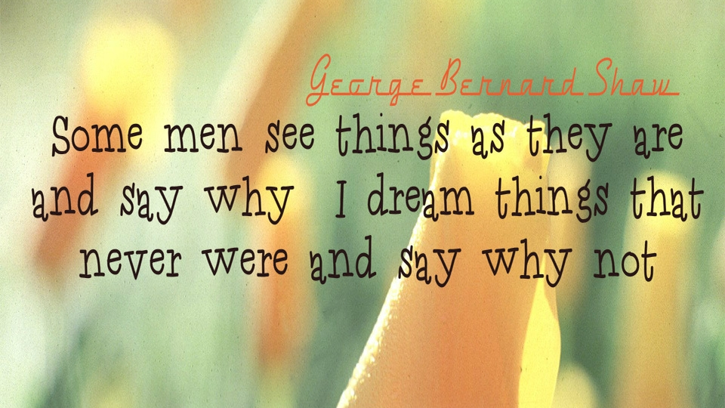
Notes:
Ultimately, we are not here to assign blame – to ask why Decatur does not have enough parks. We are here to ask that you work with us to solve it. It is not too late to find the resources and political will to create more great spaces in Decatur. Let’s continue the Decatur tradition of dreaming what our City can be, and being bold enough to ask “Why not?”

Slide 14
Thank You and Questions
www.downtowndecaturneighbors.com
George Dusenbury
Chair, Downtown Decatur Neighbors
gdusenbury4@gmail.com
404-604-7803

Slide 15
APPENDIX

Slide 16
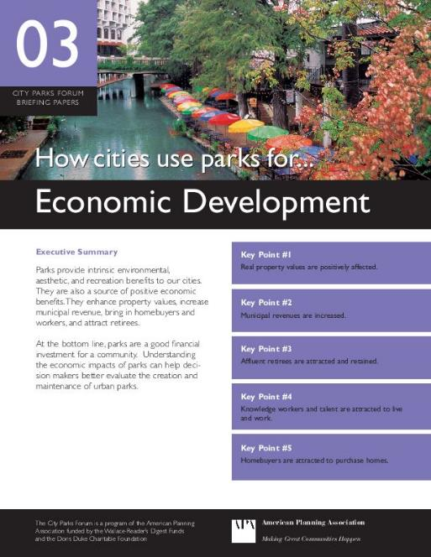
Parks need not be a drain on city coffers – they actually can increase revenue
Real property values are positively affected.
Municipal revenues are increased.
Affluent retirees are attracted and retained.
Talented knowledge workers are attracted to live and work.
Homebuyers are attracted to purchase homes.
Notes:
They also will not pay as much for a residence without access to parkland. Studies by the real estate industry consistently find that residents want access to parks and recreation areas. Millenials and seniors, who increasingly can locate wherever they wish, also are more likely to locate in an area with easy access to parkland. Decatur has successfully competed for these residents, which is driving current development. However, the City may become the victim of its own success if it does not invest in downtown parkland to continue to improve quality of life amid growing density and development.

Slide 17

Baseline – Nearly 10 Acres of Land
With No Park within 500’
417,500 square feet
Property is assessed at $X per square foot
VALUE TO TAX DIGEST
417,500 x $X =
$417,500X
Notes:
So lets start with ten acres of privately-owned property with no public parks. Each year, ten acres of land contribute to the tax digest at a given tax rate of “X” dollars per square foot.

Slide 18
Creating a One-acre Park
Reduces Taxable Land by 10%
417,500 square feet
-43,500 square feet
374,000 square feet
$0 Property Tax Revenue
Notes:
If the public sector acquires an acre of land and turns it into a public park, then only nine acres of land are paying taxes. On its face, creating the park would seem to reduce tax revenue by 10%.

Slide 19
Property Value of Remaining Land
Increases ~20%
Previously
$X per square foot
Now
$1.2X per square foot
$0 Property Tax Revenue
+20%
Notes:
Except that it doesn’t – because creating the park increased the value of all of the land around it – by an average of more than 20%. Land that once was valued at $100,000 an acre now would be valued at $120,000. This is not me making up numbers – this is peer-reviewed academic research encompassing 100 studies.

Slide 20
Resulting in Increased Tax Revenue of 5.8% - 7.5%
374,000 square feet is assessed at $1.2X per square foot
new value to
tax digest $448,800X
(less old value) - $417,500X
+ $31,300X
$0 Property Tax Revenue
Property Tax Revenue
374,000 x $1.2 X = $448,800X
Notes:
At the end of the day – and as counter-intuitive as it may seem, taking an acre of land off the tax rolls actually increases tax revenue.

Slide 21
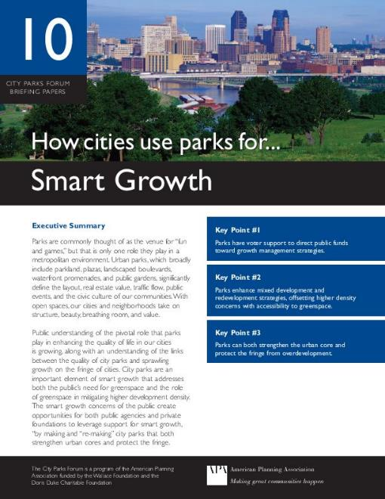
Retaining Decatur’s character – strengthening its brand - requires investing in parks
Key Point #1
Parks have voter support to direct public funds toward growth management strategies.
Key Point #2
Parks enhance mixed development and redevelopment strategies, offsetting higher density concerns with accessibility to greenspace.
Key Point #3
Parks can both strengthen the urban core and protect the fringe from overdevelopment.
Notes:
Decatur is a smart growth city. Its strategic plan, its zoning and its transportation policies all promote a livable, walkable, high-quality of life environment. In suburban, residential areas, its greenway program provides access to nature for nearby residents.
Its downtown development plan does not call for any additional greenspace and, as we have seen, will result in the loss of existing greenspace. Dense development without the creation of new parkland actually will reduce the quality of life downtown and inhibit smart growth. People are less likely to give up their yards and move downtown if there is no substitute to meet their needs for nature, leisure and recreation.

